Slide 1

Minor Project
RAINFALL PREDICTION MODEL
Amit Kumar Prajapati
Course: B.Voc Software Development
University Roll no: 22020107025

Slide 2

OVERVIEW
The primary goal of this project is to predict whether it will rain or not based on historical weather data. This prediction is made using a Random Forest model, which is a robust machine learning algorithm.
Components:
Datasets
Main Script(RainPrediction.py)
Data Loading
Data Processing
Modal Training
Predictions
Data Visualisation
GitHub: https://github.com/HuntersKing/Rainfall-Prediction.git

Slide 3




TECHNOLOGIES USED:
Python
Numpy
Pandas
MatplotLib
SciKit-Learn
Seaborn
Pickle

Slide 4
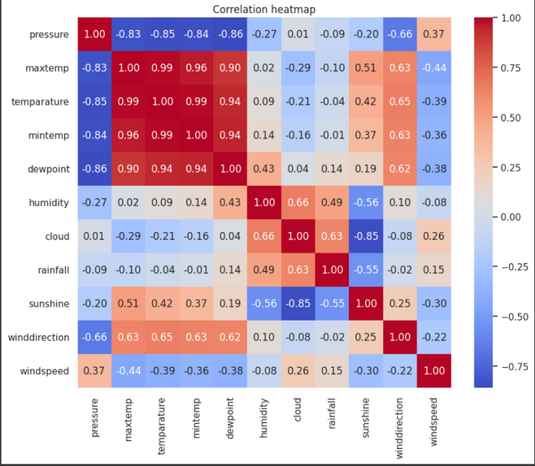
DATA FEATURES
Key weather parameters used:
Atmospheric Pressure
Dewpoint
Humidity
Cloud Coverage
Sunshine Duration
Wind Speed
Wind Direction

Slide 5
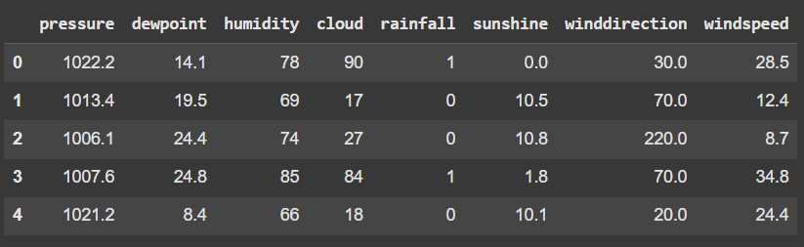
DATA PREPROCESSING
Data Collection
Data Cleaning
Feature Engineering
Historical rainfall data, temperature, humidity, wind speed, and atmospheric pressure are collected from meteorological stations and satellites.
Removing missing values, outliers, and inconsistencies ensures data quality and improves model accuracy.
Removing highly correlated features, Balancing dataset through downsampling

Slide 6
MODEL EVALUATION
model_data = {"model": best_rf_model, "feature_names": X.columns.tolist()}
with open("rainfall_prediction_model.pkl", "wb") as file:
pickle.dump(model_data, file)
Cross-validation scores
Test set accuracy
Confusion matrix
Classification report

Slide 7
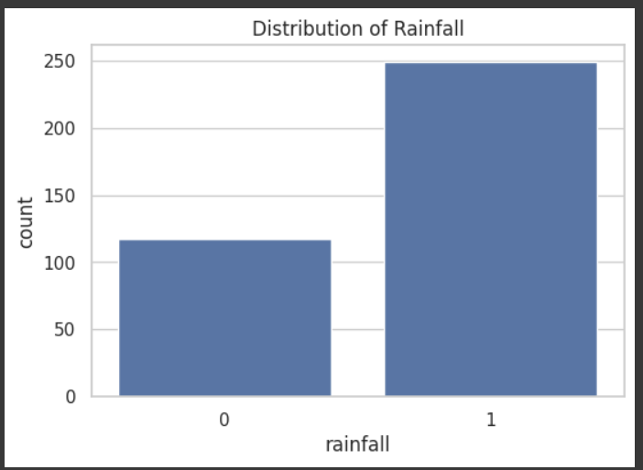
FUTURE SCOPE
Additional feature engineering
Deep learning implementation
Real-time weather data integration
Web interface development

